Slide 1
Index
Osha KPI Matrix
Data Collection, Database Design, and Reporting system
Predictive Modeling (statistic and ML)

Slide 2
OSHA kpi
OSHA has established specific mathematic calculations that enable any company to not only monitor their own performance, but also they are comparable across any department, division or group.
SEVERITY RATE – a mathematical calculation that describes the number of lost days experienced as compared to the number of incidents experienced.
OSHA Recordable Incident Rate The is calculated by multiplying the number of recordable cases by 200,000, and then dividing that number by the number of labor hours at the company.
LOST WORKDAY RATE – a mathematical calculation that describes the number of lost work days per 100 full-time employees in any given time frame.

Slide 3
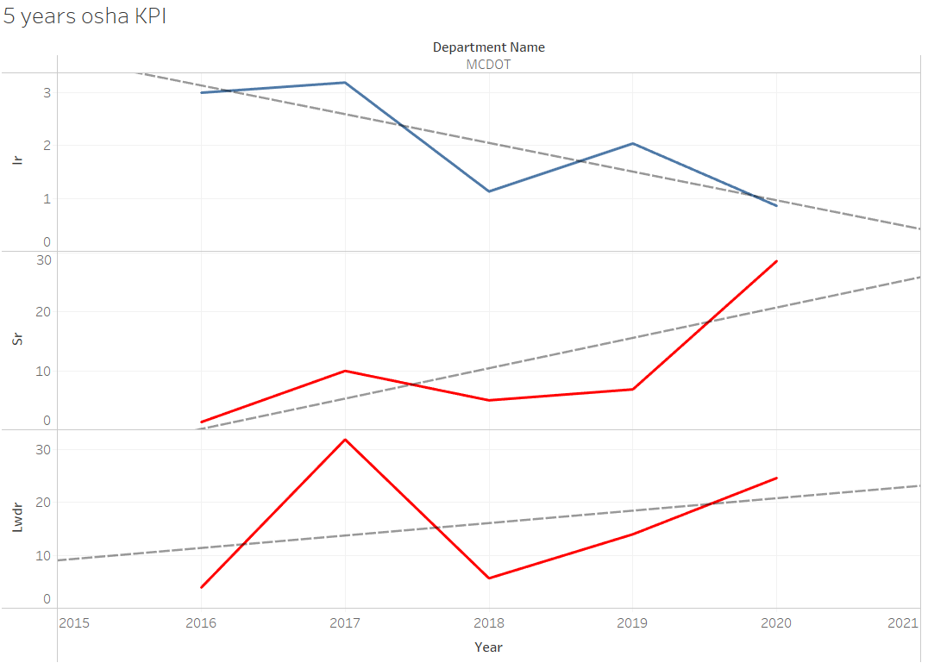
OSHA kpi
Ir (Incident Rate)
Sr (Severity Rate)
Lwdr (Lost work days rate)

Slide 4

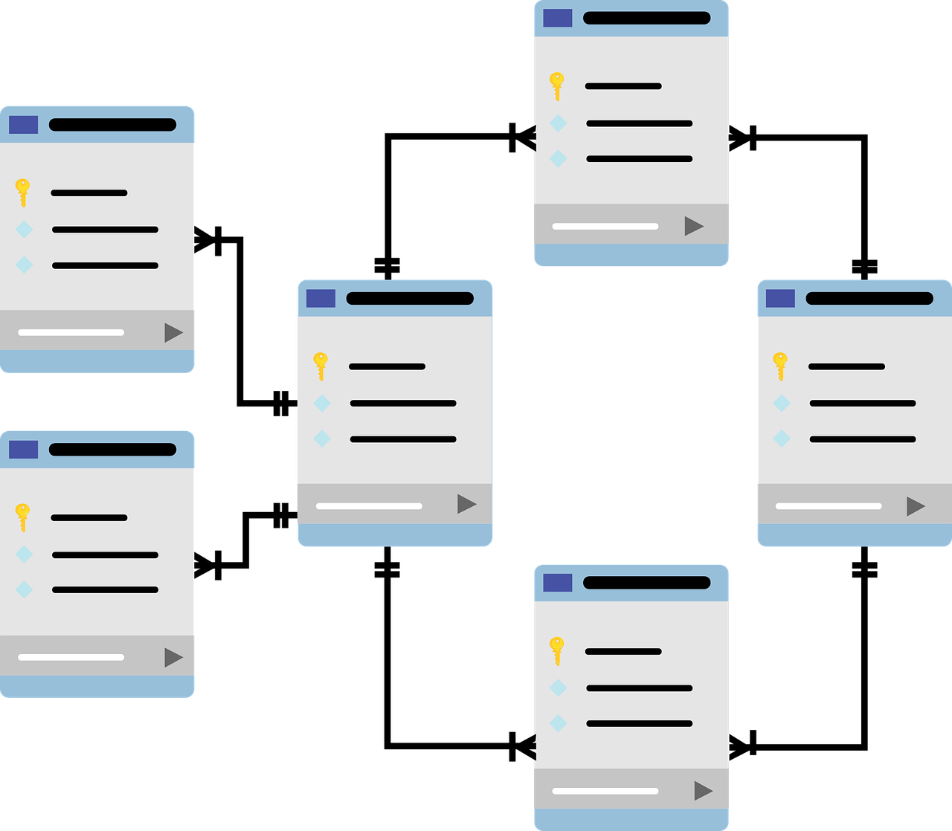
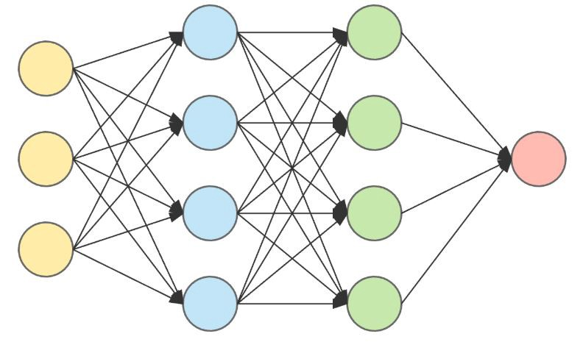
Data Science Role
Data Engineer
Data Analyst
Data Scientist

Slide 5
Problem statement
With a good problem statement, teams:
Align their efforts toward a common goal
Define what that goal is
Care about meeting the goal
Problem statements fall apart when they’re too vague or too prescriptive. Ultimately, you and your team need to judge whether a problem statement is working for you. Does it help your team recognize what their focus is? Does it keep you aligned in the same direction?

Slide 6

Data collection
The hardest part about building Forecasting Model & AI based systems isn’t in model selection or implementation, it’s in collecting quality data and identifying relevant features.
Level of details: Domain expertise

Slide 7


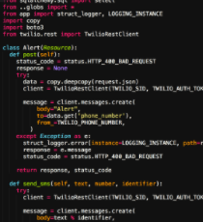

Database design
Automated Data Center
Dircks Physical Ticket
Beltmann Database
Daniel Database

Slide 8
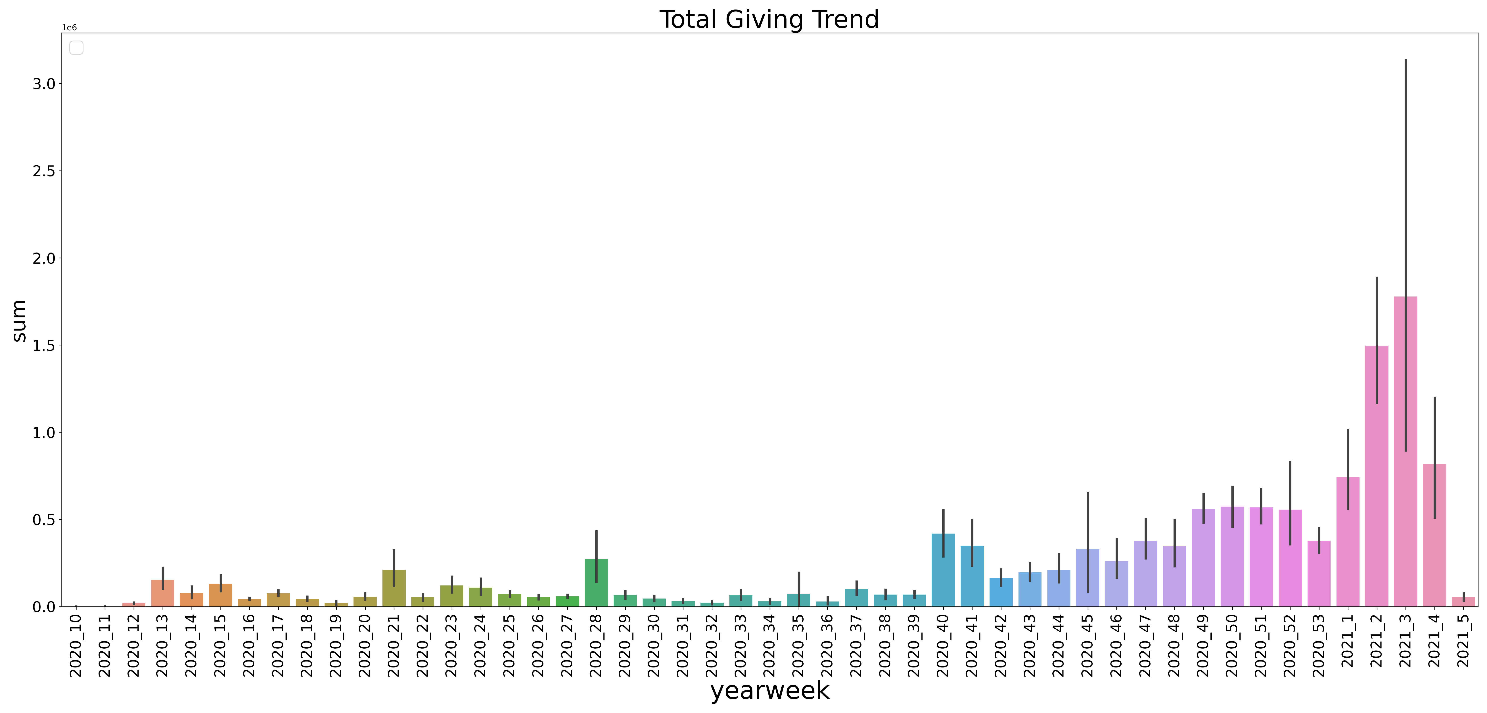
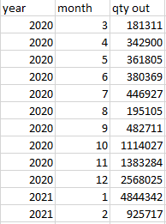
Report System

Slide 9
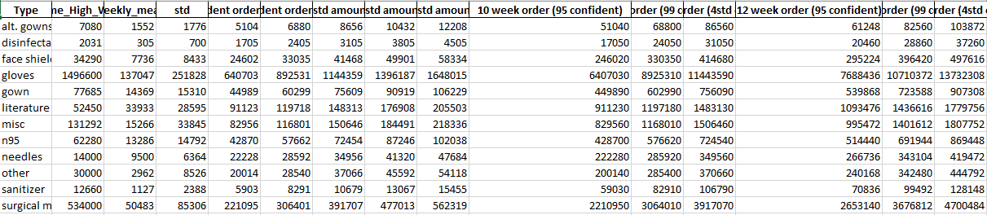

Slide 10
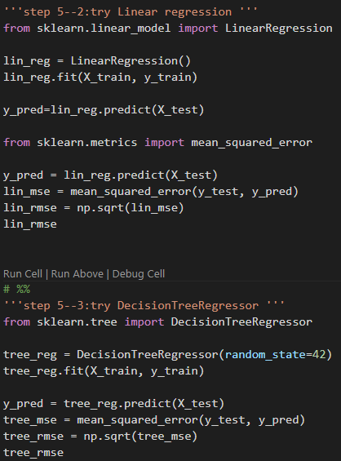
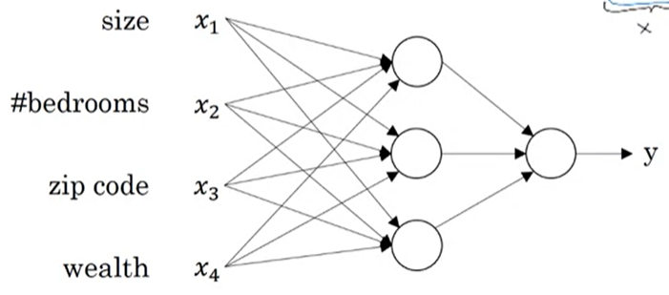
ML Failed, Data feature is not descriptive

